Slide 1

Lecture 3
Introduction to SAP Controlling (CO)
FIN319

Slide 2
Learning Objectives
Understand the goal of SAP Controlling (CO)
Understand the purpose, master data and reporting of CCA
Understand the purpose, master data and reporting of PCA
Understand the purpose, master data and reporting of Internal orders
Understand the purpose, master data and reporting of Product Costing
Understand the purpose, master data and reporting of Profitability Analysis
Understand the integration of CO and FI

Slide 3
Introduction CO
SAP Controlling (CO)

Slide 4
SAP Controlling (CO)
Goal
Goal
SAP Controlling is to provide organizations with a method of slicing and dicing data to view costs from an internal management perspective and provide a view of profitability beyond that of basic financial reporting.
  Controlling allows an organization to plan and track overhead costs within the company's specific organizational structure.
Standard reports include:
  Cost center performance
  Profit center performance
  Financial planning (Budget)
Internal
Executives
Senior Management
Admin staff
Employees

Slide 5
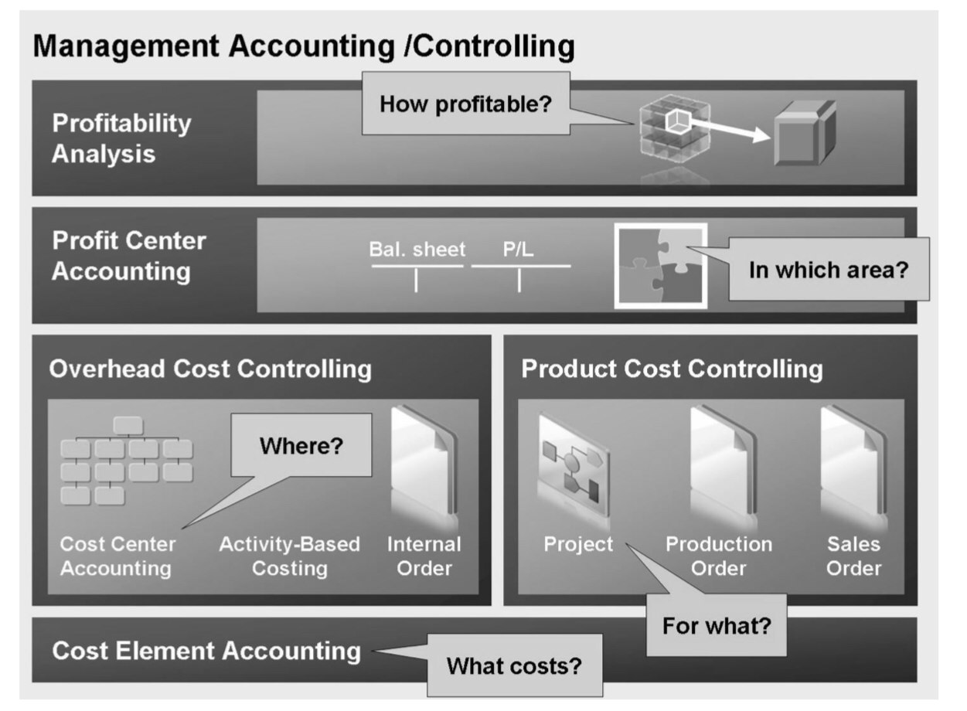
SAP Controlling (CO)
Overview
SAP Controlling (CO) help to answer the main questions that are relevant to the management team
  How profitable is a product?
  Which business unit is generating?
  Where is cost allocated?
  What is the cost per product?

Slide 6
SAP Controlling (CO)
Business process: Record to Report
Covers the process from the recording of a transaction to the analysis.
Transaction
Financial consolidation
GL close
Accounting provisions
Analysis
Tax and statutory reporting
It involves the collecting, processing, and delivering information that is relevant, accurate and timely. It provides the feedback needed in the organization to understand what is its the financial performing.

Slide 7
SAP Controlling (CO)
S/4 Finance: Costing Management and PA
Use for the recording of the financial needs of the organization and the focus of this lecture
Benefits
  Have a clear idea of your cost drivers
    Expenses
  Identify profitable customers, channels, and products
    Revenue and cost
  Run what-if profitability models
Financial Planning & Analysis
Accounting and Financial Close
Treasury Mgnt
Invoice Mgnt & AP
Accounting & Closing Operations
Accounting
Cost Mgnt & PA
Products
Digital Core
S/4 HANA

Slide 8

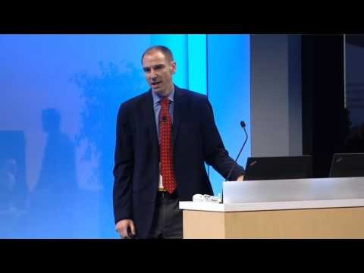
SAP Controlling (CO)
The case of Carter’s
How Carter’s used S/4 HANA Finance to:
Consolidate its financial system’s landscape from 20 to 1
Standardize their financial business processes
Improve efficiency
Gain visibility into its financial operations
Expand its business process beyond SAP S/4 HANA into SAP Ariba
https://sapinsider.wispubs.com/Assets/Case-Studies/2016/December/IP-A-Next-Generation-Finance-Platform-at-Carters

Slide 9
SAP Controlling (CO)
Organizational Structure
Org
Represents the legal and/or organizational views of an enterprise and it forms a framework that supports the activities of a business in the manner desired by management
  The controlling area identifies a self-contained organizational structure for which costs and revenues can be managed and allocated.
  May contain one or more company codes, which can operate in different currencies.
  Company codes within a controlling area must all use the same operational chart of accounts and fiscal year variant
Represents an independent legal accounting unit.
Balanced set of books, as required by law, are prepared at this level.
Company code
Client
Controlling Area
An independent environment in the system.

Slide 10
SAP Finance Operations (FI)
Organizational Structure (Cont)
Org
It represents an organizational unit in your company for which the sales market data has a uniform structure (dimensions). It is the valuation level for profitability analysis (CO_PA)
Multiple controlling areas can be assigned to one operating concern.
The plant represents a production unit and is the central organizational unit in Materials Management and Production Planning.
A plant is assigned to a company code.
Operating Concern
Plant
Cost Center
Hierarchy
Profit Center Hierarchy
It is a tree structure representing all the cost centers belonging to a controlling area from a controlling perspective.
It is a tree structure representing all the profit centers belonging to a controlling area from a controlling perspective.

Slide 11

SAP Controlling (CO)
Global Bike Controlling Structure
One Operating concern
Two controlling areas
Two company codes
Five plants
  Three in North America
  Two in Europe
Global Bike
Client
Global Concern
Operating Concern
North America
Europe
Controlling Areas
Global Bike Inc
Global Bike Germany GmbH
Company code
San Diego
Dallas
Miami
Heilderberg
Hamburg
Plants

Slide 12
SAP Controlling (CO)
Sub-modules
Controlling
CCA
Cost Center and Profit Center Acct
Use to control the cost and profit incurred in the organization by department and business.
UJ
Financial Planning & Analysis
Accounting and Financial Close
Treasury Mgnt
Invoice Mgnt & AP
Accounting & Closing Operations
Accounting
Cost Mgnt & PA
Products
IOA
Internal Order Accounting
Use to control certain types of cost that requires monitoring through out the business process.
PC
Product Costing
Use to plan for the cost of materials.
Digital Core
S/4 HANA
PA
Profitability Analysis
Use to evaluate profitability by market segments and classify them by multiple dimensions (sales org, business areas, plant, company code, etc).

Slide 13




SAP Controlling (CO)
Data Types
Controlling
Master records
Single source of common business data used across SAP.
Transactional records
Data that represents a financial event.
Cost centers
Cost Center Acct
Cost transactions
Statistical
key figures
Profit Center Acct
Profit transactions
Activity types
Internal Order Acct
Order transactions
Profit centers
Product Costing
Product cost elements
Internal
orders

Slide 14
SAP Controlling (CO)
Master data extension
Controlling
Controlling
North America
Europe
Cost centers
CC-IT###
CC-IT###
Statistical
key figures
SK123
Activity types
AT456
Profit centers
PC-ABC
PC-ABC
Internal
orders
IO-123

Slide 15
SAP Controlling (CO)
Master data copy
Controlling
Controlling
North America
Europe
Cost centers
CC-IT###
CC-IT##1
Statistical
key figures
SK123
SK125
Activity types
AT456
AT500
Profit centers
PC-ABC
PC-AB1
Internal
orders
IO-123
IO-200

Slide 16

SAP Controlling (CO)
Cost and Statistical Objects
Controlling
Cost Objects
They can act as sending or receiving objects during cost allocation.
Statistical Cost Objects
They only receive allocation cost from real cost objects.
Cost centers, real internal orders, real projects, networks, make-to-order production orders, cost objects, and profitability segments.
Statistical orders, statistical projects, and profit centers.

Slide 17

SAP Controlling (CO)
Reflection
Under the GBI Controlling org structure, what are the needs you observe the GBI team may have?
What benefits do you see of having cost objects and their statistical counterparts?

Slide 18
Cost Center Accounting
Part of Universal Journal
SAP Controlling (CO)

Slide 19
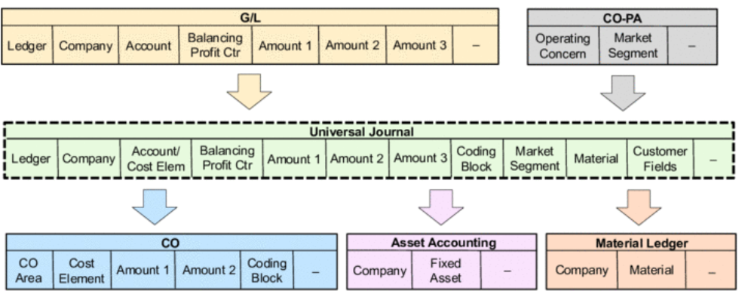
Universal Journal
Introduction
It brings together the SAP FI and CO components into a place. This “single source of truth” collects all accounting transactions with its costing elements.
  General Ledger (FI)
  Asset Accounting (FI)
  Controlling (CO)
  Profitability Analysis (CO)
  Material Ledger (CO)

Slide 20
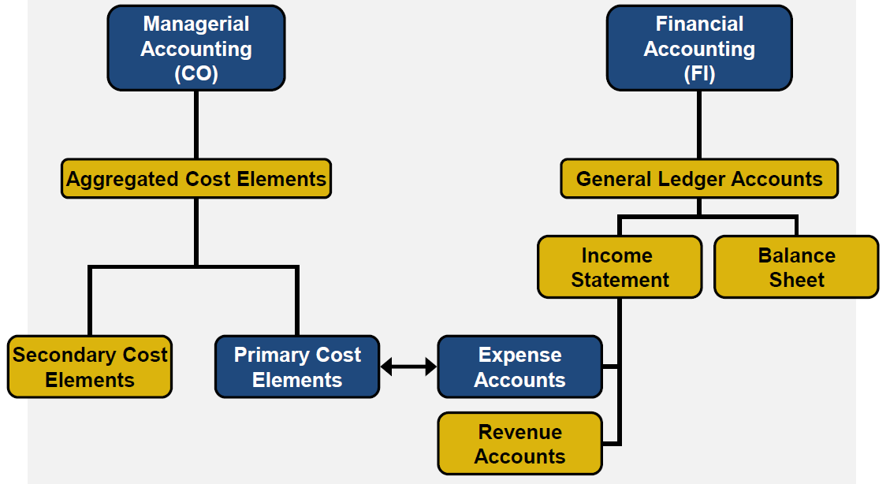
Cost Element & Cost Center Accounting
Introduction
Cost accounting
Financial Accounting (FI) is a primary source of data for Management Accounting (CO).
  Most expense postings in the general ledger result in a cost posting in Management Accounting.
  These expense postings use a cost object (cost center).
75###5 Rent
75###5 Rent
Cost objects
NAHR2###
CC-IT-###
CC-IC-###
CC-IM-###

Slide 21
Cost accounting
Controlling Area and Currencies
Cost accounting
Global Bike
Client
By assigning more than one company code to a controlling area you can perform cost accounting for all company codes
Global Concern
Operating Concern
North America
Europe
Controlling Areas
Global Bike Inc
Global Bike Germany GmbH
Company code
Transaction
Document currency
Company code
Reporting currency
Controlling
Consolidation currency
The controlling area and company codes can have the same or different currencies

Slide 22
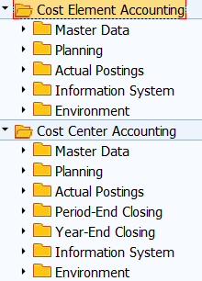
Cost Element & Cost Center Accounting
Transactions
Cost accounting
Tcode | Description | Type
KA01 | Primary cost element | Master data
KA06 | Secondary cost element | Master data
OKEON | Cost center hierarchy | Master data
KS01 | Cost center | Master data
KL01 | Activity type | Master data
KK01 | Statistical key figures | Master data
KP06 | Budget entry | Transactional
KSB1 | Cost center line items | Transactional

Slide 23

Cost Element & Cost Center Accounting
Master Data: Secondary Cost Element
Cost accounting
Exist only in CO but not in FI.
Its purpose is CO only and it is use to redistribute cost:
  Used in conjunction with various allocation techniques in CO
  Used for internal allocations within CO.
Do not have any corresponding G/L accounts in FI
Controlling
Controlling
Primarily Cost Element
Secondary Cost Element
Controlling area
Validity
Category

Slide 24
Cost Element & Cost Center Accounting
Primary Cost Element link with Secondary Cost Element
Cost accounting
Any transactions that create cost movements within CO are balanced entries.
When a cost is moved from one controlling objet to another, the sending object is credited and the receiving object is debited for the same amount.
9### Allocation
75###5 Rent
75###5 Rent
Cost objects
NAHR2###
CC-IT-###
CC-IC-###
CC-IM-###

Slide 25

Cost Center Accounting
Master Data: Cost Center
Cost accounting
The cost center is an organizational unit in a controlling area representing a clearly delimited location where costs occur
  Use cost center for:
    Differentiated assignments of overhead costs
    Organizational activities based on utilization of the relevant areas
    Differentiated controlling of costs arising in an organization
  Define a cost center for each low-level organizational unit that has responsibility for managing costs.
Basic Data
Name and description
Cost Center Hierarchy
Profit Center
Company Code
Responsible person
Business Area
Other
Category
Currency

Slide 26
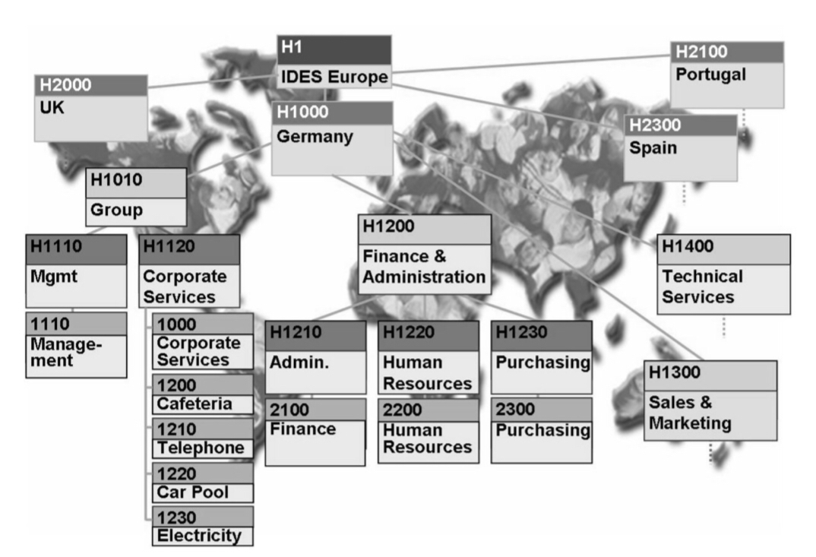
Cost Center Accounting
Cost Center Hierarchy
Cost accounting
Cost Centers require a formal structure called a hierarchy
  The standard hierarchy is a tree structure representing all the cost centers belonging to a controlling area from a controlling perspective
North America
Manufacturing
SGA
Inventory CC-###-IM
Quality CC-###-QC
Finance CC-###-FI
IT CC-###-IT
HR CC-###-HR
Controlling Area
Cost center groups
You can combine cost centers into groups by decision making, responsibilities or management areas
Cost centers
Cost objects that delimit location on where cost occurs

Slide 27

Cost Center Accounting
Master Data: Activity Types
Cost accounting
Describe an activity produced by a cost center and measured in units of time or quantity (cost per unit). It is used as the basis for internal cost distribution.
  Used to allocate cost only from cost centers:
    Cost square footage for rent
    Cost Kwatts consumption for power
    Cost number of calls for telephone
Basic Data
Name and description
Allocation type
Allocation
Activity unit
Cost center category
Allocation cost element
Price indicator

Slide 28

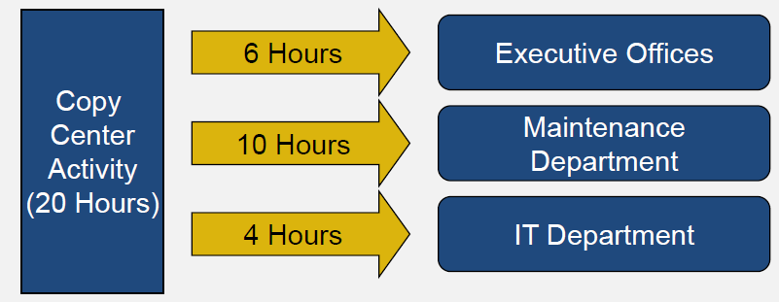
Cost Center Accounting
Master Data: Statistical Key Figures
Cost accounting
Represent numerical measures. It is used as a basis for internal cost allocations.
Used to allocation cost from cost centers, profit centers or internal orders
Can be defined as
  Fixed value (use for the remaining of the fiscal year)
  Total value (use in one particular month)
Examples
  Number of employees
  Number of hrs

Slide 29
Cost Center Accounting
CO postings: Types of Allocation
Cost accounting
Distribution
Assessment
Method of allocation both primarily and secondary cost elements
Primary and/or secondary cost elements are grouped together and transferred to receiver cost centers through use of a secondary cost element.
Method for periodically allocating primarily cost elements.
Primarily cost elements maintain their identity in both the sending and receiving objects
Cost elements
Used only by cost centers
Requires activity types
Used by cost centers, internal orders and profit centers
Requires statistical key figures
Cost objects & allocation
Document
Sender and receiver cost centers are fully documented in a unique controlling (CO) document

Slide 30


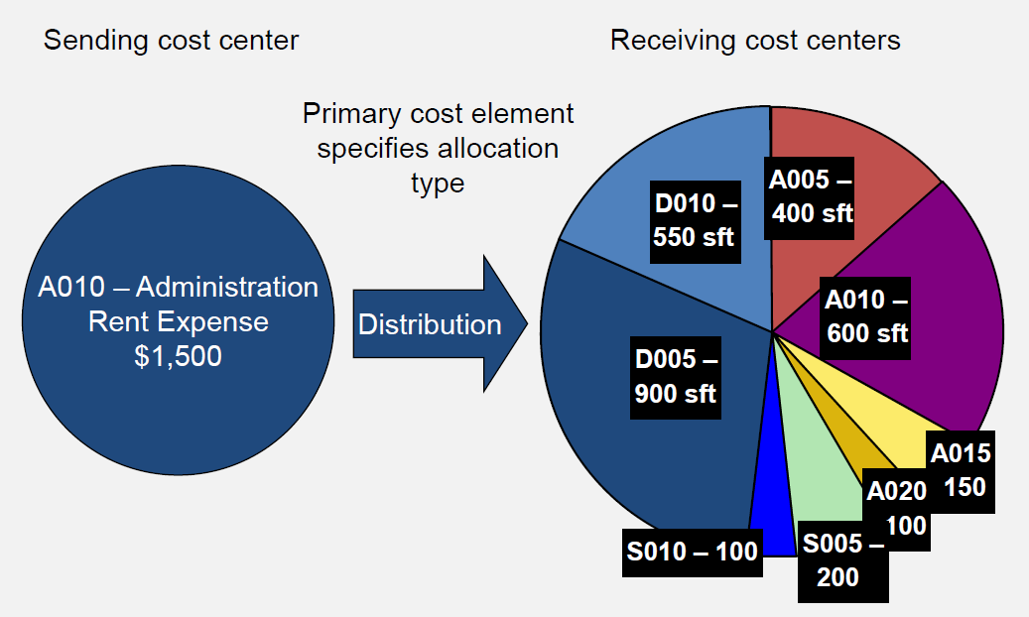
Cost Center Accounting
CO postings: Distributions
Cost accounting
Original cost center
Activity type: square footage
Target cost centers
The purpose is to allow a cost center to charge for services or activities
  It requires activity types (master data) as a tracing factor (units of measure) for the allocation of cost.
  Cost is distributed to other cost centers from the same primarily cost element.
  Cost distribution happen only on CO without disturbing the original GL posting.
FI (GL)
CO (CCA)
Primarily cost element

Slide 31
Cost Center Accounting
Distributions: CO Impact
Cost accounting
Company code
Posting & Document date
Transaction date
Document number
Currency
Line items
  Primarily cost element
  Cost centers
  Amounts
Document date:
09/01/2018
Company code:
US00
Posting date:
09/01/2018
Currency:
USD
Document Number
1XXXXXXX
Transaction date:
09/15/2018
Item in document currency
Line
PK
Account
Cost Center
Amount
001
40
75XXXX Rent
Target Cost center
$1,000.00
002
40
75XXXX Rent
Target Cost center
$ 500.00
003
50
75XXXX Rent
Original cost center
$1,500.00-

Slide 32

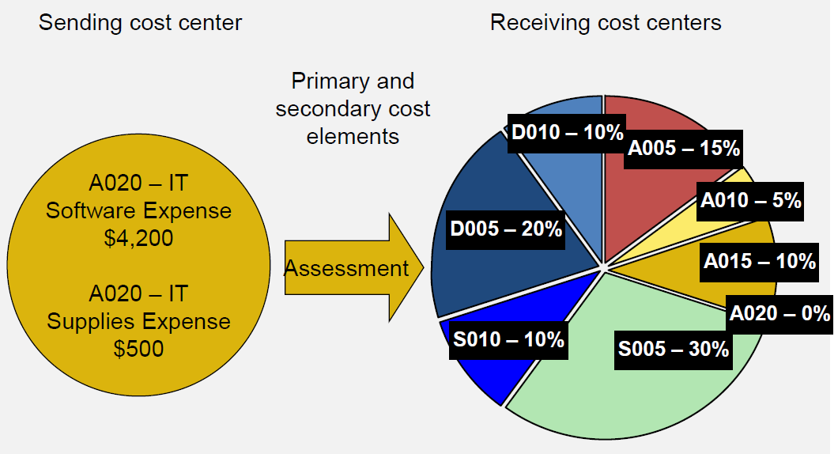
Cost Center Accounting
CO postings: Assessment
Cost accounting
Cost object
Stat. Key Fig
Target cost objects
Assessment affords a higher level of summarization for allocations
  It requires statistical key figures as the base for allocation
  Cost is allocated to other cost objects from primarily or secondarily cost elements
  Cost allocation happen only on CO and postings will be combined on a secondary cost element
    The only way to further allocate secondary costs is to use assessments.
CO(CCA)
CO (CCA)
Secondary cost element

Slide 33
Cost Center Accounting
Assessments: CO Impact
Cost accounting
Company code
Posting & Document date
Transaction date
Document number
Currency
Line items
  Secondary cost element
  Cost centers
  Amounts
Document date:
09/01/2018
Company code:
US00
Posting date:
09/01/2018
Currency:
USD
Document Number
1XXXXXXX
Transaction date:
09/15/2018
Item in document currency
Line
PK
Account
Cost Object
Amount
001
40
95XXXX Rent
Target Cost object
$3,000.00
002
40
95XXXX Rent
Target Cost object
$1,700.00
003
50
95XXXX Rent
Original cost object
$4,700.00-

Slide 34
Cost Center Accounting
Budget
Cost accounting
Benefits
Goal
  Calculate planning costs to define deviations later and to prepare the allocation to the cost bearers.
  Based on absorption costing, it allocates all the costs in overhead area to the cost bearers in a company using different procedures.
Planning
To plan the structure of the organization’s future operations for a clearly defined period.
Control
To control business methods within the current settlement period using plan/actual or target/actual comparisons
Budget
Monitor
To monitor the efficiency after the completion of the settlement period using plan/actual or target/actual comparisons
Benchmark
To provide a basis for the valuation of organizational activities independent of random fluctuations

Slide 35
Cost Center Accounting
Reflection
What currencies would be involved in a CO transaction on Global Bike Inc?
What currencies would be involved in a CO transaction on Global Bike Germany?
What would you recommend GBI in Germany to be its cost center structure and hierarchy and why?
What examples can you provide for GBI distribution process?
What examples can you provide for GBI assessment process?
What would you say is the main purpose of having the distribution and allocation process in SAP?
What benefits you can derive for having your cost center budget in SAP?

Slide 36
Profit Center Accounting
Part of Universal Journal
SAP Controlling (CO)

Slide 37
Profit Center Accounting
Introduction
Profit accounting
Purpose is to determine profit (revenue and cost) for internal areas of responsibility, and it is integrated to the New GL
Common use
  Region
  Function
  Product
Other
Profit Center
Profit $200
Revenue
Expense
Revenue:
Sales for $1,000
Expense:
Allocation for $800

Slide 38
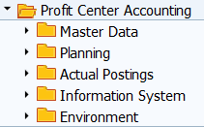
Profit Center Accounting
Transactions
Profit accounting
Tcode | Description | Type
KE51 | Profit center | Master data
KCH1 | Profit center hierarchy | Master data
KE5Z | Profit center actual line items | Transactional

Slide 39
Profit Center Accounting
Master Data: Profit Center
Profit accounting
An organizational unit in accounting that reflects a management-oriented structure of the organization for purpose of internal controls
  Profit center accounting is a statistical accounting component
  It takes transaction data posted in other components and represents it from a profit-center-oriented point of view.
  Can be used on the balance sheet to analyze working capital.
Basic Data
Controlling area
Validity
Name & description
Company codes
Other
Responsible
Hierarchy group

Slide 40
Profit Center Accounting
Data Flow
Profit accounting
Profits centers can receive data from:
Direct postings
Document splitting
Balance
Sheet
Profit Center
Sales
Revenue
Expense
GL

Slide 41
Profit Center Accounting
Reflection
Which currencies would you think a Global Bike Germany profit center document would have?
What do you think GBI can use profit center accounting for considering they are a manufacturing company.

Slide 42
Internal Order Accounting
Part of Universal Journal
SAP Controlling (CO)

Slide 43
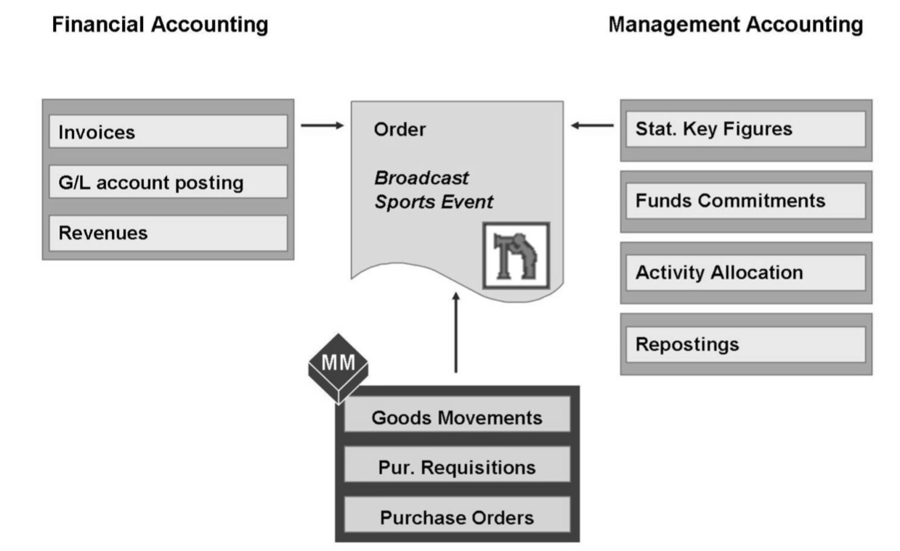


Internal Order
Introduction
Internal order
It is an interim (short term) cost collector
that gets set to zero balance at the end (settlement)
Cost breakdown
Project cost
Campaign cost
Travel cost
Planning
Tracking individual
events

Slide 44
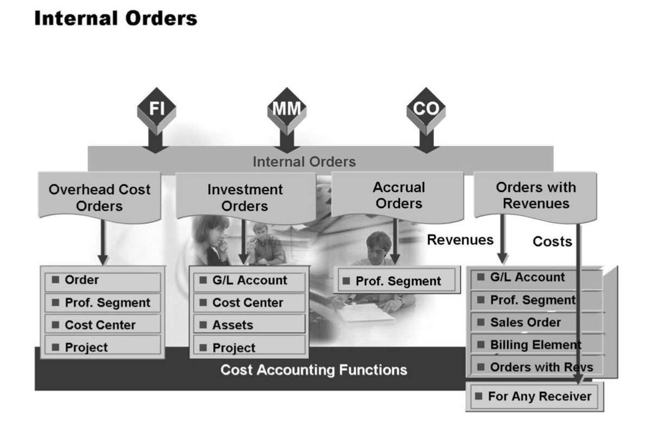
Internal Order
Order Types
Internal order
Used to replace the cost accounting parts of SD customer orders if SD is not being used.
Used to monitor costs incurred for a particular purpose
Used to monitor costs incurred in the production of a fixed asset
Used to offset postings of accrued costs to cost centers

Slide 45
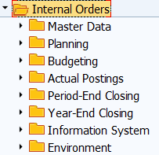
Internal Order
Transactions
Internal order
Tcode | Description | Type
KO01 | Create order | Master data
 | Planning | Transactional
KO88 | Posting and settlement | Transactional
KOB1 | Actual line items | Transactional

Slide 46

Internal Order
Master Data
Internal order
Is a self-contained mini project cost object with an interim life.
It can settle cost at the end of its life into:
  Fixed assets
  Projects
  Profit centers
Basic Data
Order and description
Category
Other
Company code
Controlling area
Plant
Profit center
Responsible
Currency

Slide 47
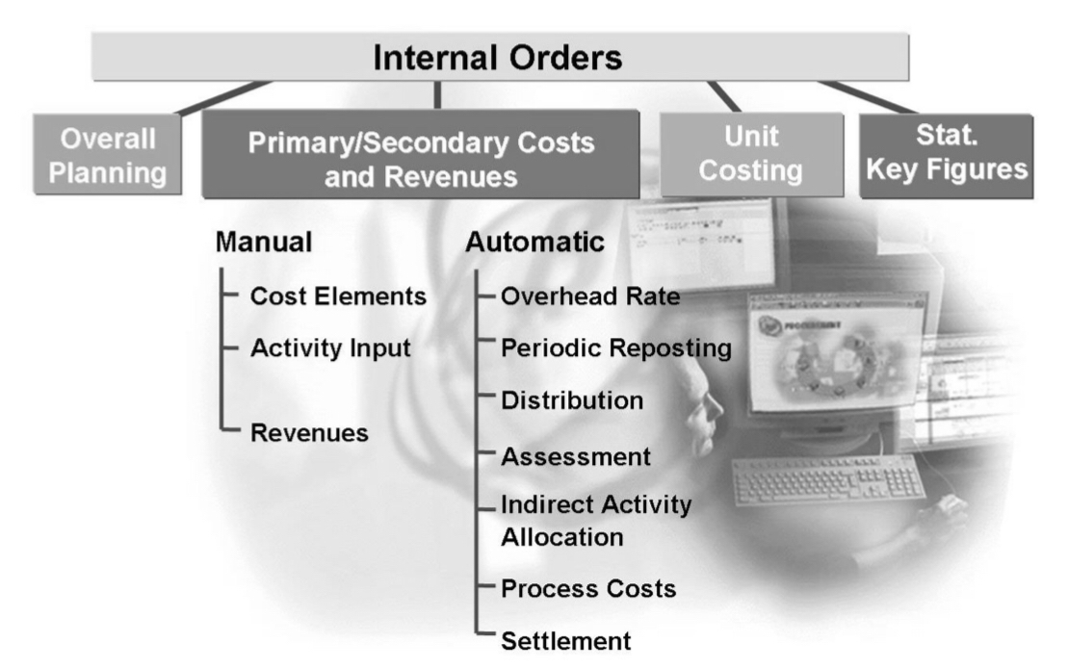
Internal Order
Planning
Internal order
Order Planning
Controls cost, activities, and business processes that you expect to incur during the lifecycle of an order.
Budget/Actuals
Using internal order planning, you can compare plan and actual costs, and carry out a differentiated variance analysis
Order planning

Slide 48
Internal Order
Transaction: Posting
Internal order
Posting
  An internal order is a bucket that allows a better view of costs that could not be itemized in detail in a cost center.
  An order can be
    Real (cost object)
    Statistical (informational postings only).
  If it is a statistical posting, the cost object for that the internal order is attached to would receive the real posting.

Slide 49
Internal Order
Posting: Financial impact
Internal order
Company code
Posting & Document date
Transaction date
Document number
Currency
Line items
  Internal order
  Posting key (debits and credits)
  Amounts
Document date:
09/01/2018
Company code:
US00
Posting date:
09/01/2018
Currency:
USD
Document Number
1XXXXXXX
Transaction date:
09/25/2018
Item in document currency
Line
PK
Account
Internal order
Amount
001
40
229XXX AuC
12AB Order
$1,700.00
002
31
123 Vendor X
$1,700.00-

Slide 50
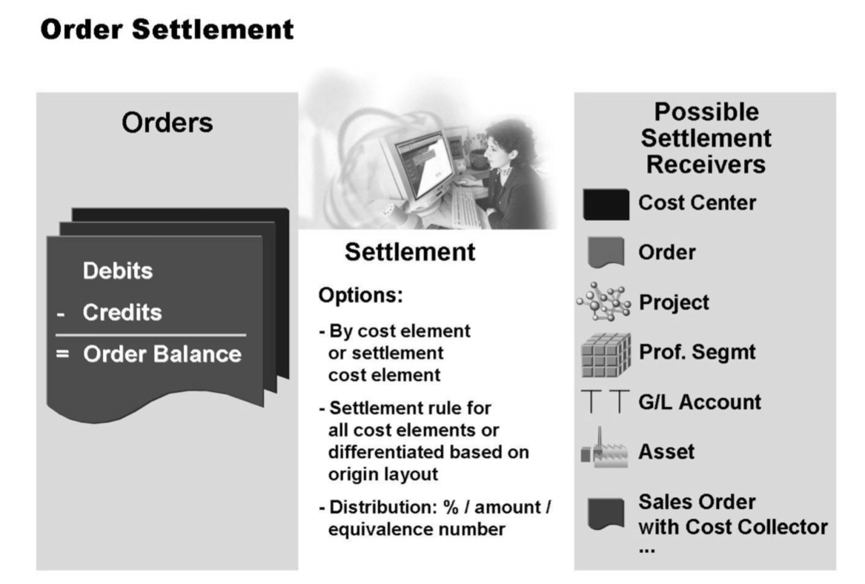
Internal Order
Transaction: Settlement
Internal order
Settlement
  Another form of periodic cost allocation.
  Internal orders must be settled because they are interim collectors of costs.
  The order will be periodically credited and a receiver will debited with cost.
  Can occur at the end of each period or at the end of the order’s life.
  Real internal orders have FI and CO impact, while statistical only CO.

Slide 51

Internal Order
Transaction: Settlement Rule
Internal order
Settlement rule establishes the sender and receiver relationship as well as how much each receiver will receive during settlement.
Receivers must be defined as valid in customizing and no impending system restrictions (such as locks) prevent settlement.
Cost
center
Cost
collectors
Other
Orders
Orders
COPA
Projects
Fixed
Assets

Slide 52
Internal Order
Settlement: Financial impact
Internal order
Company code
Posting & Document date
Transaction date
Document number
Currency
Line items
  Internal order
  Posting key (debits and credits)
  Amounts
Document date:
09/01/2018
Company code:
US00
Posting date:
09/01/2018
Currency:
USD
Document Number
1XXXXXXX
Transaction date:
09/25/2018
Item in document currency
Line
PK
Account
Internal order
Amount
001
40
22XXXX Asset
$1,700.00
002
50
229XXX
12AB Order
$1,700.00-

Slide 53
Internal Order
Reflection
What would you say is the difference between a cost center and an internal order?
What would you recommend the GBI team to use internal orders for?
What the “settlement” activity has to do with the interim life of an internal order?

Slide 54
Product Costing
SAP Controlling (CO)

Slide 55
Product Costing
Introduction
Product costing
Concerned with all aspects of planning the cost of producing products or services, as well as tracking and analyzing actual costs and consist three components on the right.
Costing methodology
  Product Cost Planning
  Actual Costing and Material Ledger
Material
Cost of material
Labor
Cost of labor
Overhead
Cost of overhead

Slide 56

Product Costing
Transactions
Product costing
Tcode | Description | Type
MM01 | Material master | Master data
CK40N | Costing run | Transactional
CKMLCP | Actual costing run | Transactional

Slide 57
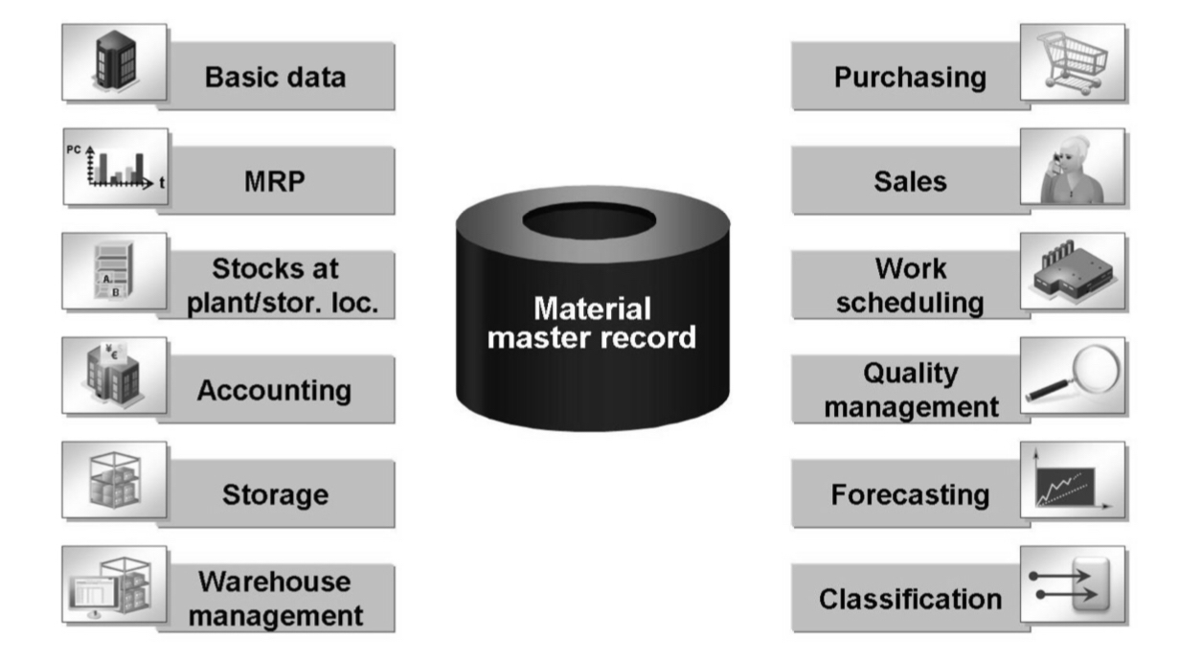
Product Costing
Master Data: Material Master Views
Product costing
Basic
Sales
Purchasing
Plant
Forecast
Storage
Quality
Accounting
Controlling

Slide 58
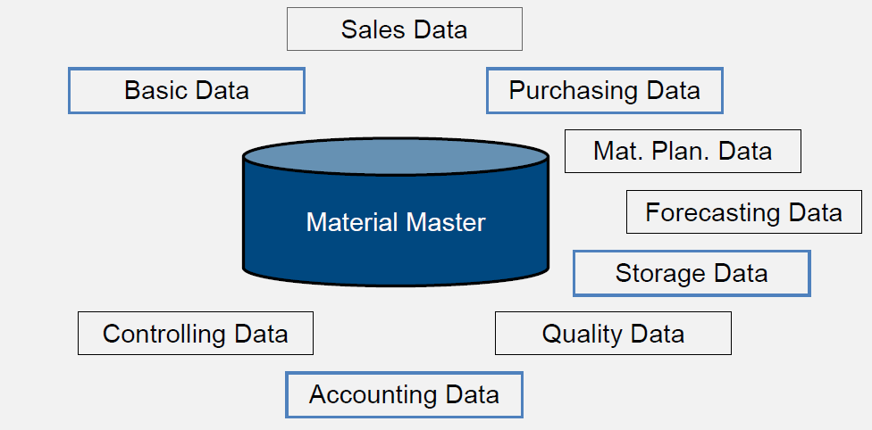
Product Costing
Master Data: Material Master Views
Product costing
Basic
Sales
Purchasing
Plant
Forecast
Storage
Quality
Accounting
Controlling

Slide 59
Product Costing
Master Data: Material Master (MM01)
Product costing
Contains all of the key information a company needs to manage a material within its organization.
The material master defines, among other things, how a product is sold, manufactured, purchased, inventoried and costed.
Information is grouped into views that are organized by business function.
The majority of views of master data are stored at the plant level.
Basic Data
Material
Valuation class
Accounting and Costing
Unit of measure
Material group
Description
Controls account determination
Price control
Price per unit
Standard price
Previous price
Last price change
Profit center
Cost estimate

Slide 60
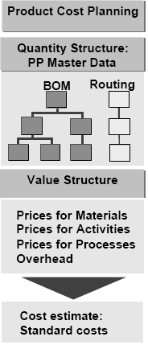
Product Costing
Product Cost Planning
Product costing
Used to estimate the costs to produce goods or services.
If no quantity structure is available you can either enter the cost items manually with the unit costing tool or transfer them automatically from a non-SAP system using batch input.
If a quantity structure (bill of material and routing) is available in manufacturing Planning, then the system can automatically create a cost estimate based on this data.

Slide 61
Product Costing
Using Quantity Structure
Product costing
Bill of Materials (BOM)
  It identify the components necessary to produce a finish or semi-finish good.
  GBI Off road bike
    2 Aluminum wheels
    1 Frame
    1 Seat kit
    1 Handle bar
    1 Pedal assembly
    1 Chain
    1 Brake kit
Material | Qty | Std Cost Total Cost
Off Road Bike | 1 | $155 | $155
Wheels | 2 | $10 | $20
Frame | 1 | $40 | $40
Seat | 1 | $10 | $10
Handle | 1 | $20 | $20
Pedal | 1 | $10 | $10
Chain | 1 | $10 | $10
Brakes | 1 | $15 | $15
Labor | 2hr | $15 | $30

Slide 62
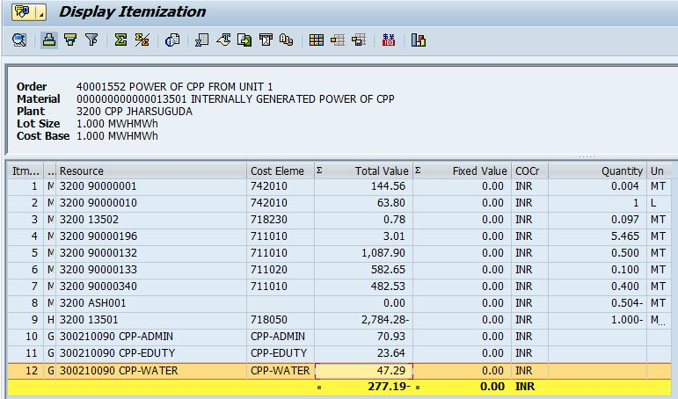
Product Costing
Costing Run: Itemizations
Product costing
Itemizations show detailed information about the origin of costs.
Cost element itemizations groups the individual cost items into cost elements. The cost element group the costs in order of appearance.
Cost component split groups the cost elements into cost components.

Slide 63
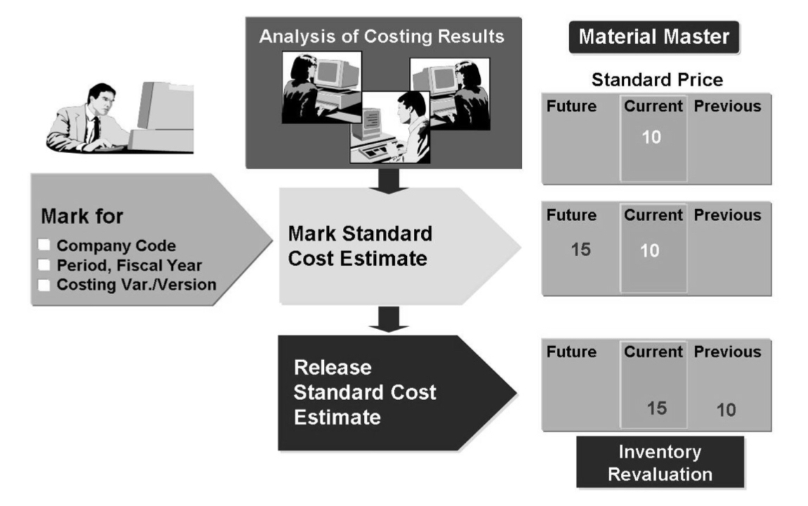
Product Costing
Transaction: Costing Run (CK40N)
Product costing
Mark Standard Cost
  The system writes the result of the cost estimate into the costing view of the material master record as the future standard price.
  You can use this price to valuate a material component in the cost estimate.

Slide 64
Product Costing
Transaction: Costing Run (CK40N)
Product costing
Release Standard Cost
  The system transfers the result of the standard cost estimate into the material master record as the material standard price.
  Inventory revaluation:
    The price is then active for Financial Accounting and is used for the valuation of the material until the next time a standard cost estimate is released.
  You can release a standard cost estimate only once per period, unless you delete the previously released standard cost estimate.

Slide 65
Product Costing
Inventory revaluation: Financial Impact
Product costing
Inventory on had
  1 Off road Bike
  Balance: $150
Previous standard cost:
  $150 per Bike
New cost estimated:
  $155 per Bike
Document date:
09/01/2018
Company code:
US00
Posting date:
09/01/2018
Currency:
USD
Document Number
1XXXXXXX
Transaction date:
09/15/2018
Item in document currency
Line
PK
Account
Amount
001
40
20XXXX Inventory
$ 5.00
002
50
79XXXX COGS
$ 5.00-

Slide 66
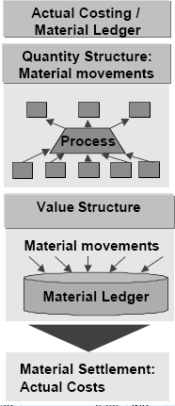
Product Costing
Actual Costing
Product costing
Used to provide actual costs for each material at the end of the period.
Materials and their movements are valuated with a standard price during the period.
Any variances with respect to this standard are collected in the material ledger when invoices are received or orders settled.
During period end closing, the variances are used to calculate an actual price for the material in the closed period.

Slide 67
Product Costing
Reflection
What it means to “estimate the cost”?
What is the inventory effect after a costing run?
What impact would you have in your cost of goods sold when the engineering team may have revisions to the BOM in the middle of the period.

Slide 68
Profitability Accounting
SAP Controlling (CO)

Slide 69
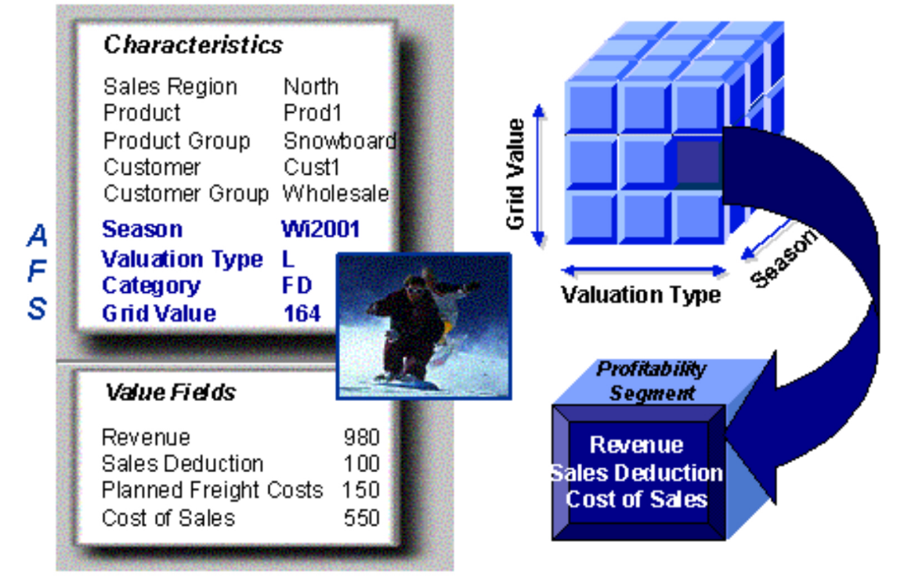
Profitability Accounting
Introduction
PA
Enables you to evaluate contribution margins of external market segments which can be classified according to:
  Products
  Customers
  Orders
  Strategic business units,
    Sales organizations or
    Business areas
It is only relevant for CO

Slide 70



Profitability Accounting
Introduction
PA
PA Components
Cost Assessments
Hierarchy
Overhead management
Product cost controlling
Cost centers
Activity based costing
Settlement from internal orders
Production variance from cost objects
Collect info from organizational elements such us
Company code
Business area
Plant
Sales org
Customer
Profit center

Slide 71
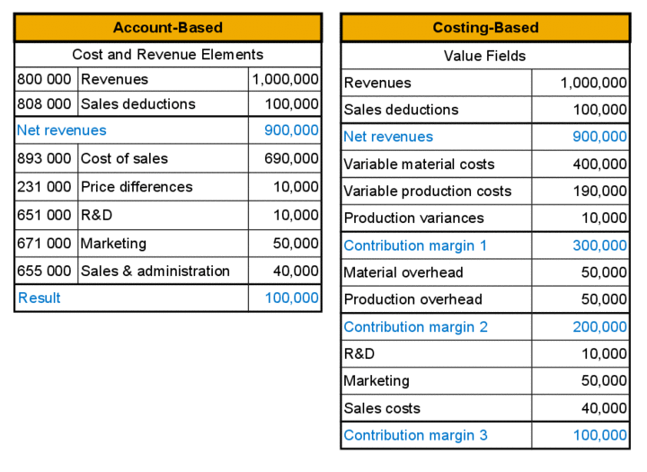
Profitability Accounting
Introduction: Data Flow
PA
Data from sales order management is one of the key sources of information.
  In costing-based profitability analysis information can be taken when an order is created or changed and when an invoice is generated for the order.
  In account-based profitability analysis information can be taken when a goods issue is posted and when an invoice is generated for the goods issue.

Slide 72
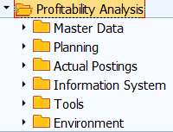
Profitability Accounting
Transactions
PA
Tcode | Description | Type
KE30 | Execute report | Transactional
KE24 | Line item display | Transactional

Slide 73
Profitability Accounting
Reflection
What would be your recommendation for the GBI team on how to use CO-PA?
What type of data would you expect to see on the CO-PA document?

Slide 74
SAP Controlling (CO)
Reflection
It is month end at GBI and the managerial accounting group is working on its month end close, what activities would you need to review in each of the areas below
  Cost center accounting
  Profit center accounting
  Internal order accounting
  Product costing
  Profitability analysis

Slide 75
Summary of Lecture
Introduction to SAP Controlling
  Goal of SAP Controlling
  SAP CO Org structure
  Cost Center Accounting
  Profit Center Accounting
  Internal Order Accounting
  Product Costing
  Profitability Analysis

Slide 76

SAP Controlling (CO)
The case of Carter’s
Transformation Finance:
  Evolving toward decision guidance
Business process redesign
Centralize invoice management
https://www.digitalistmag.com/finance/2017/01/19/transforming-role-of-finance-at-iconic-retailer-carters-04853833

Slide 77
SAP Controlling
Practice
Create cost center group
Create cost center
Create budget/forecast
Create statistical key figure
Plan number of employees
Post rent invoice
Create allocation
View allocation results
Review budget vs actuals
Master data
Transactional data
Display

Slide 78
SAP Controlling
Practice: Data relationship
Cost center
Cost center group
Statistical key figure
Plan number employees
Allocation
Review assessment
Post invoice
Review budget vs actuals
Budget
Master data
Transactional data
Display

Slide 79
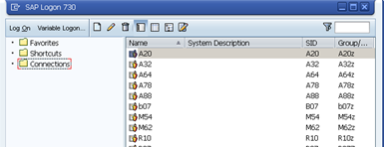

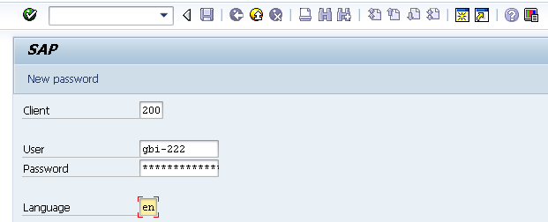
SAP Controlling
User Logon Screen
Click on the icon in your desktop.
Enter the following information:
System ID: Eagle
Client: 118
User ID: LEARN-XXX
Enter your password
Notes:
Enter Client, Server and Password
Client is a numeric field and this number represents a whole business entity.
Users are client specific which means that having a user identification in one client will only allow access to that particular client.
The system settings are stored in a file on your machine called the saplogin.ini file. This file is normally preconfigured centrally and then made available to all the users. Once you have been provided with the SAP Logon, you need a username and password to logon to the SAP system. The username and password is unique for each user and you do have the option to change your password using the New password button available on the screen.

